Slide 1

Data Science for Policy Independent analysis Data Science Campus Graduate Programme September 2023
Notes:
Hi,
I hope that you are all doing well this morning, my name is Jac Williams. As a data scientists in the spatial data unit in the department of levelling up, our role involves exploring the spatial differences across the UK using data to provide insights and recommendations.

Slide 2
Has the increasing price of energy affect commuters’ transport habits?
Main Points
12 levelling up missions
Welsh devolution of education
Different data collection methods
Comparability
Data Science for Policy – September 2023
2
2
Notes:
In particular, we centre our analysis around the 12 levelling up missions, of which, one of the missions is education, which has stated metrics such as the number of primary school children achieving the expected standard in reading, writing and maths. Today, we are interested in if there are spatial disparities in school absences across both England and Wales and how this links to the other levelling up metrics. The governance of education has been devolved in Wales since the creation of the Welsh assembly in 1999 and therefore the collection of school absence data is done independently between England and Wales. The differences in the data collection methods amount to things such as counting half day sessions missed instead of the percentage of pupils absent, how required attendance is counted, etc.

Slide 3
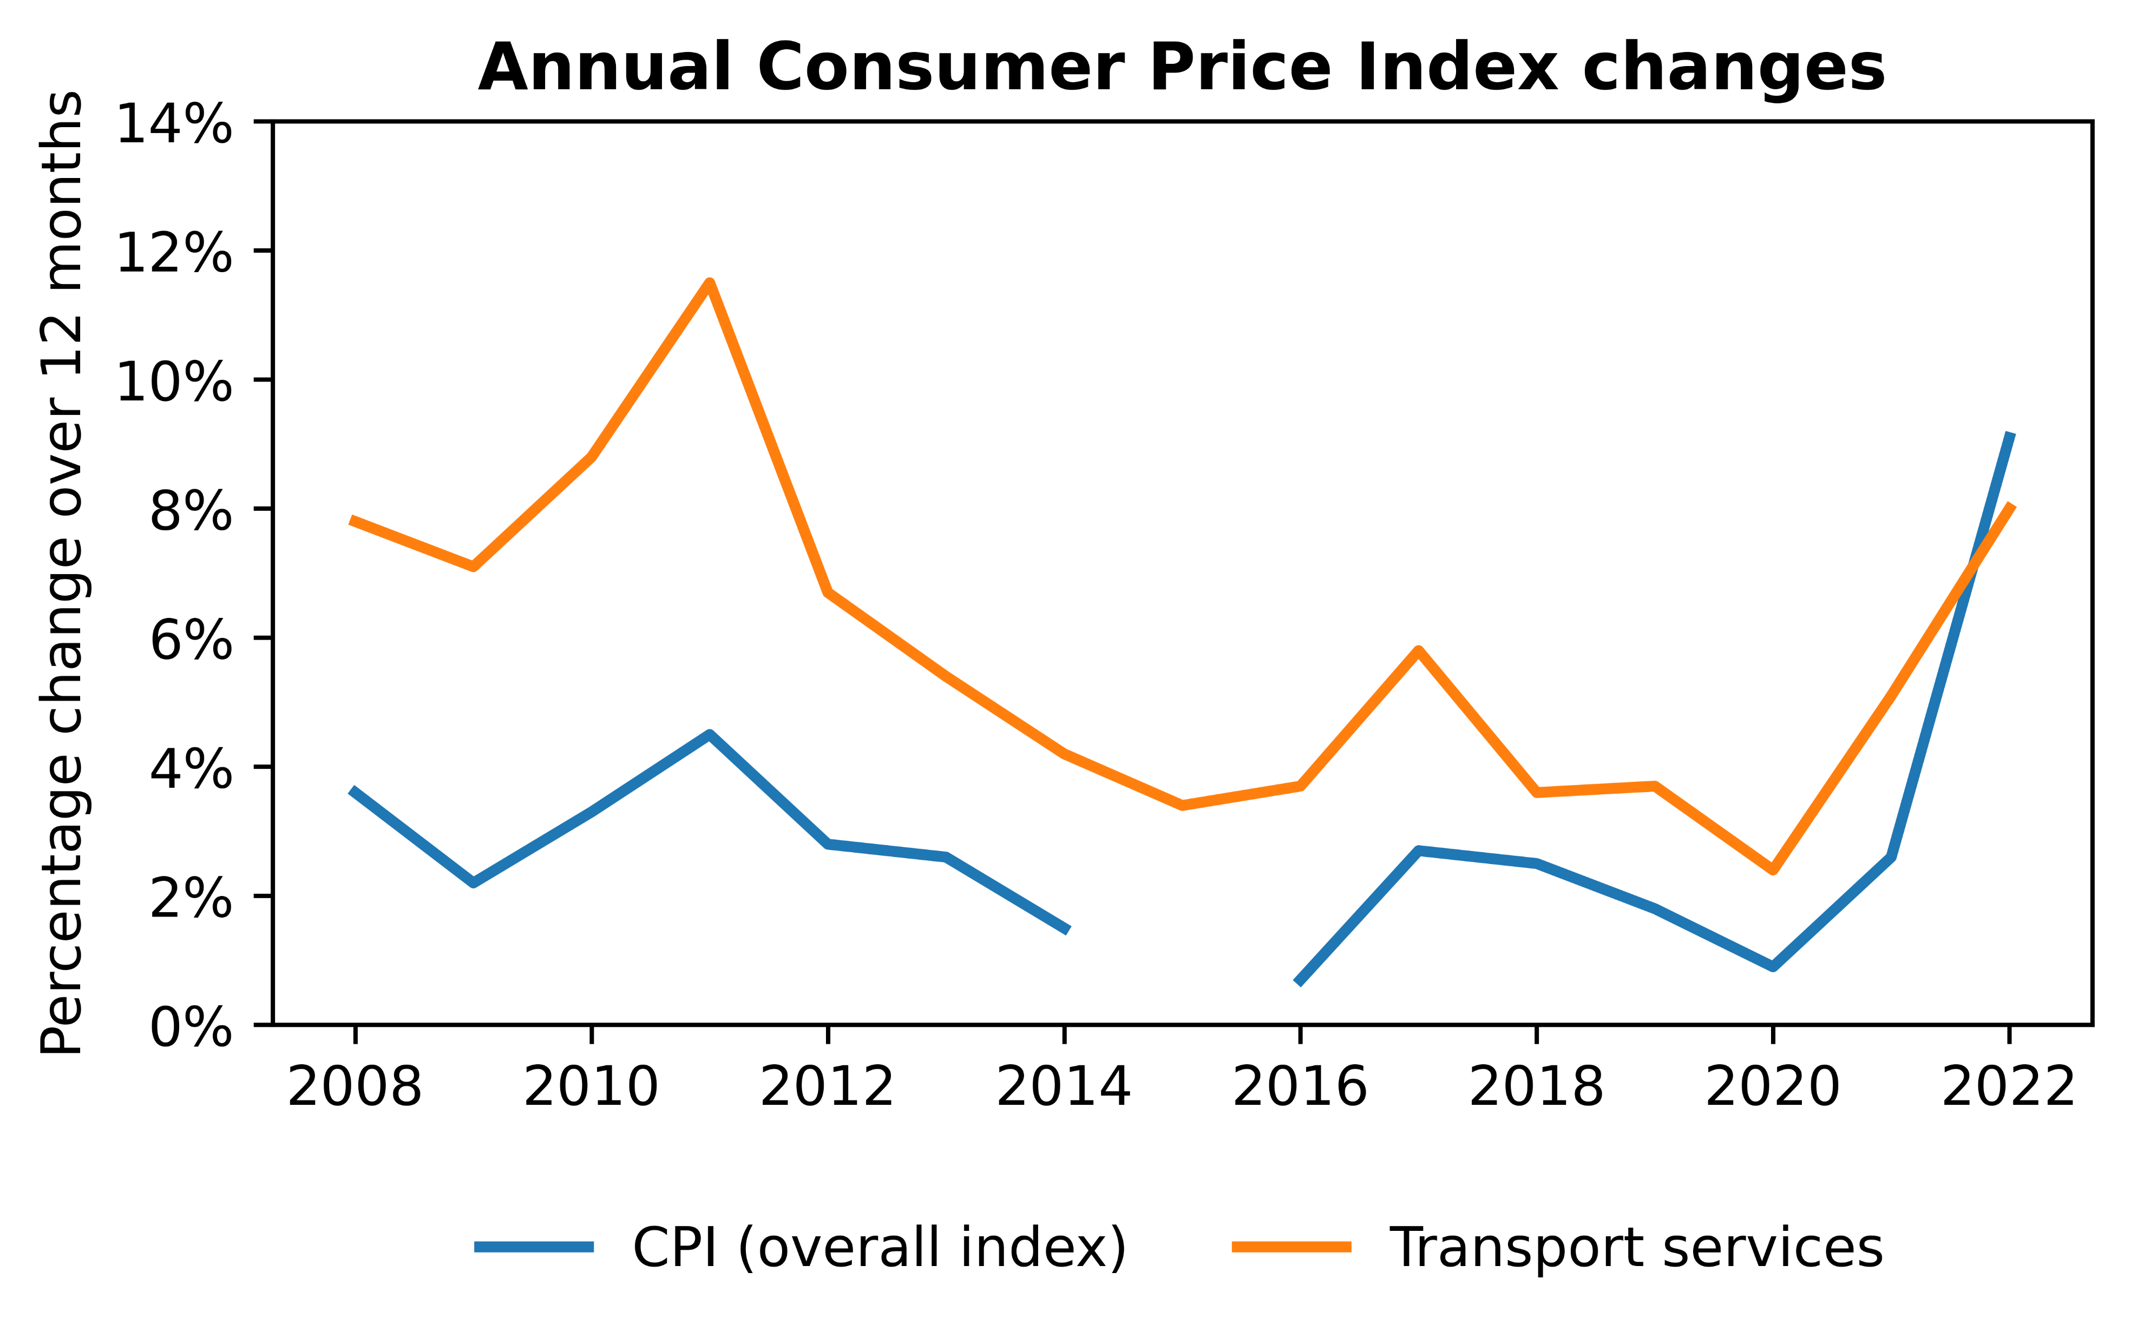
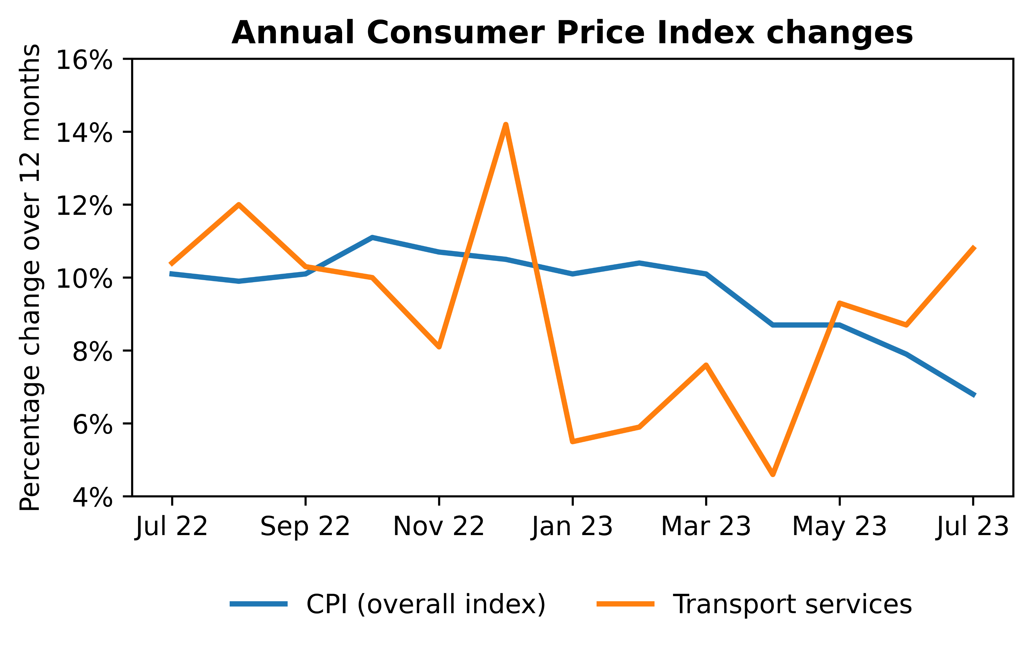
Has the increasing price of energy affect commuters’ transport habits?
CPI trends
12 levelling up missions
Welsh devolution of education
Different data collection methods
Comparability
Data Science for Policy – September 2023
3
3
Notes:
In particular, we centre our analysis around the 12 levelling up missions, of which, one of the missions is education, which has stated metrics such as the number of primary school children achieving the expected standard in reading, writing and maths. Today, we are interested in if there are spatial disparities in school absences across both England and Wales and how this links to the other levelling up metrics. The governance of education has been devolved in Wales since the creation of the Welsh assembly in 1999 and therefore the collection of school absence data is done independently between England and Wales. The differences in the data collection methods amount to things such as counting half day sessions missed instead of the percentage of pupils absent, how required attendance is counted, etc.

Slide 4
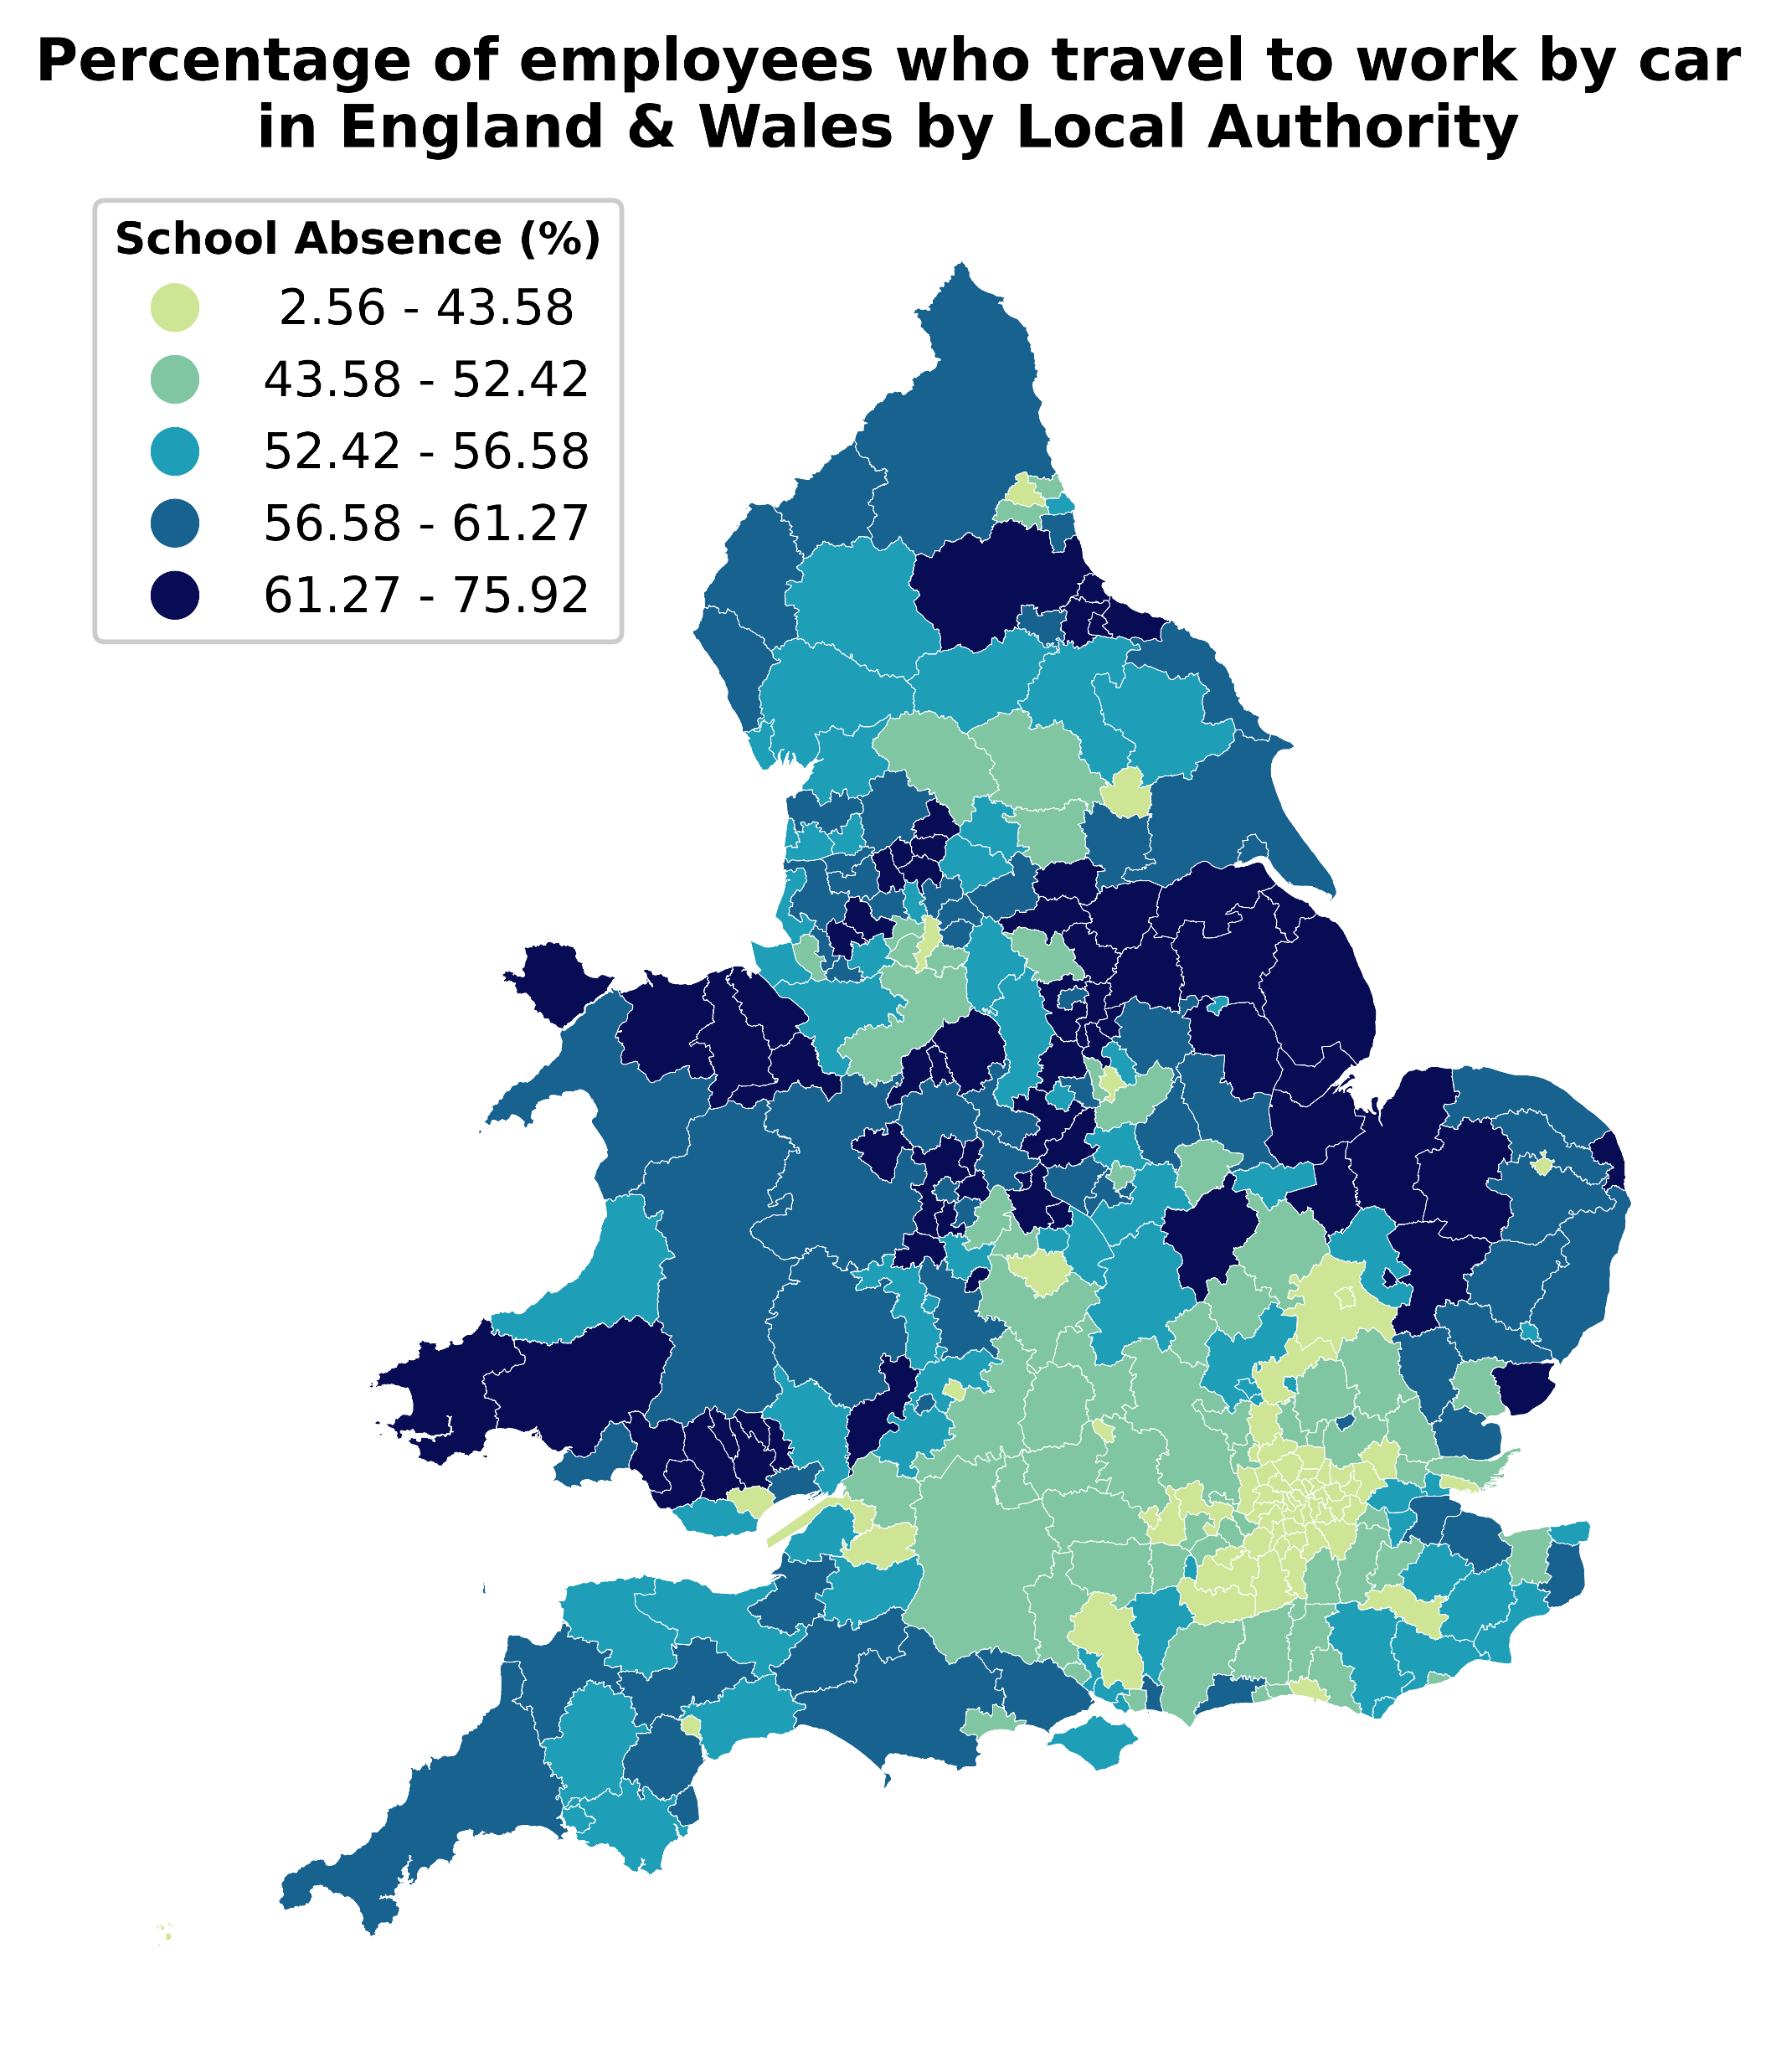
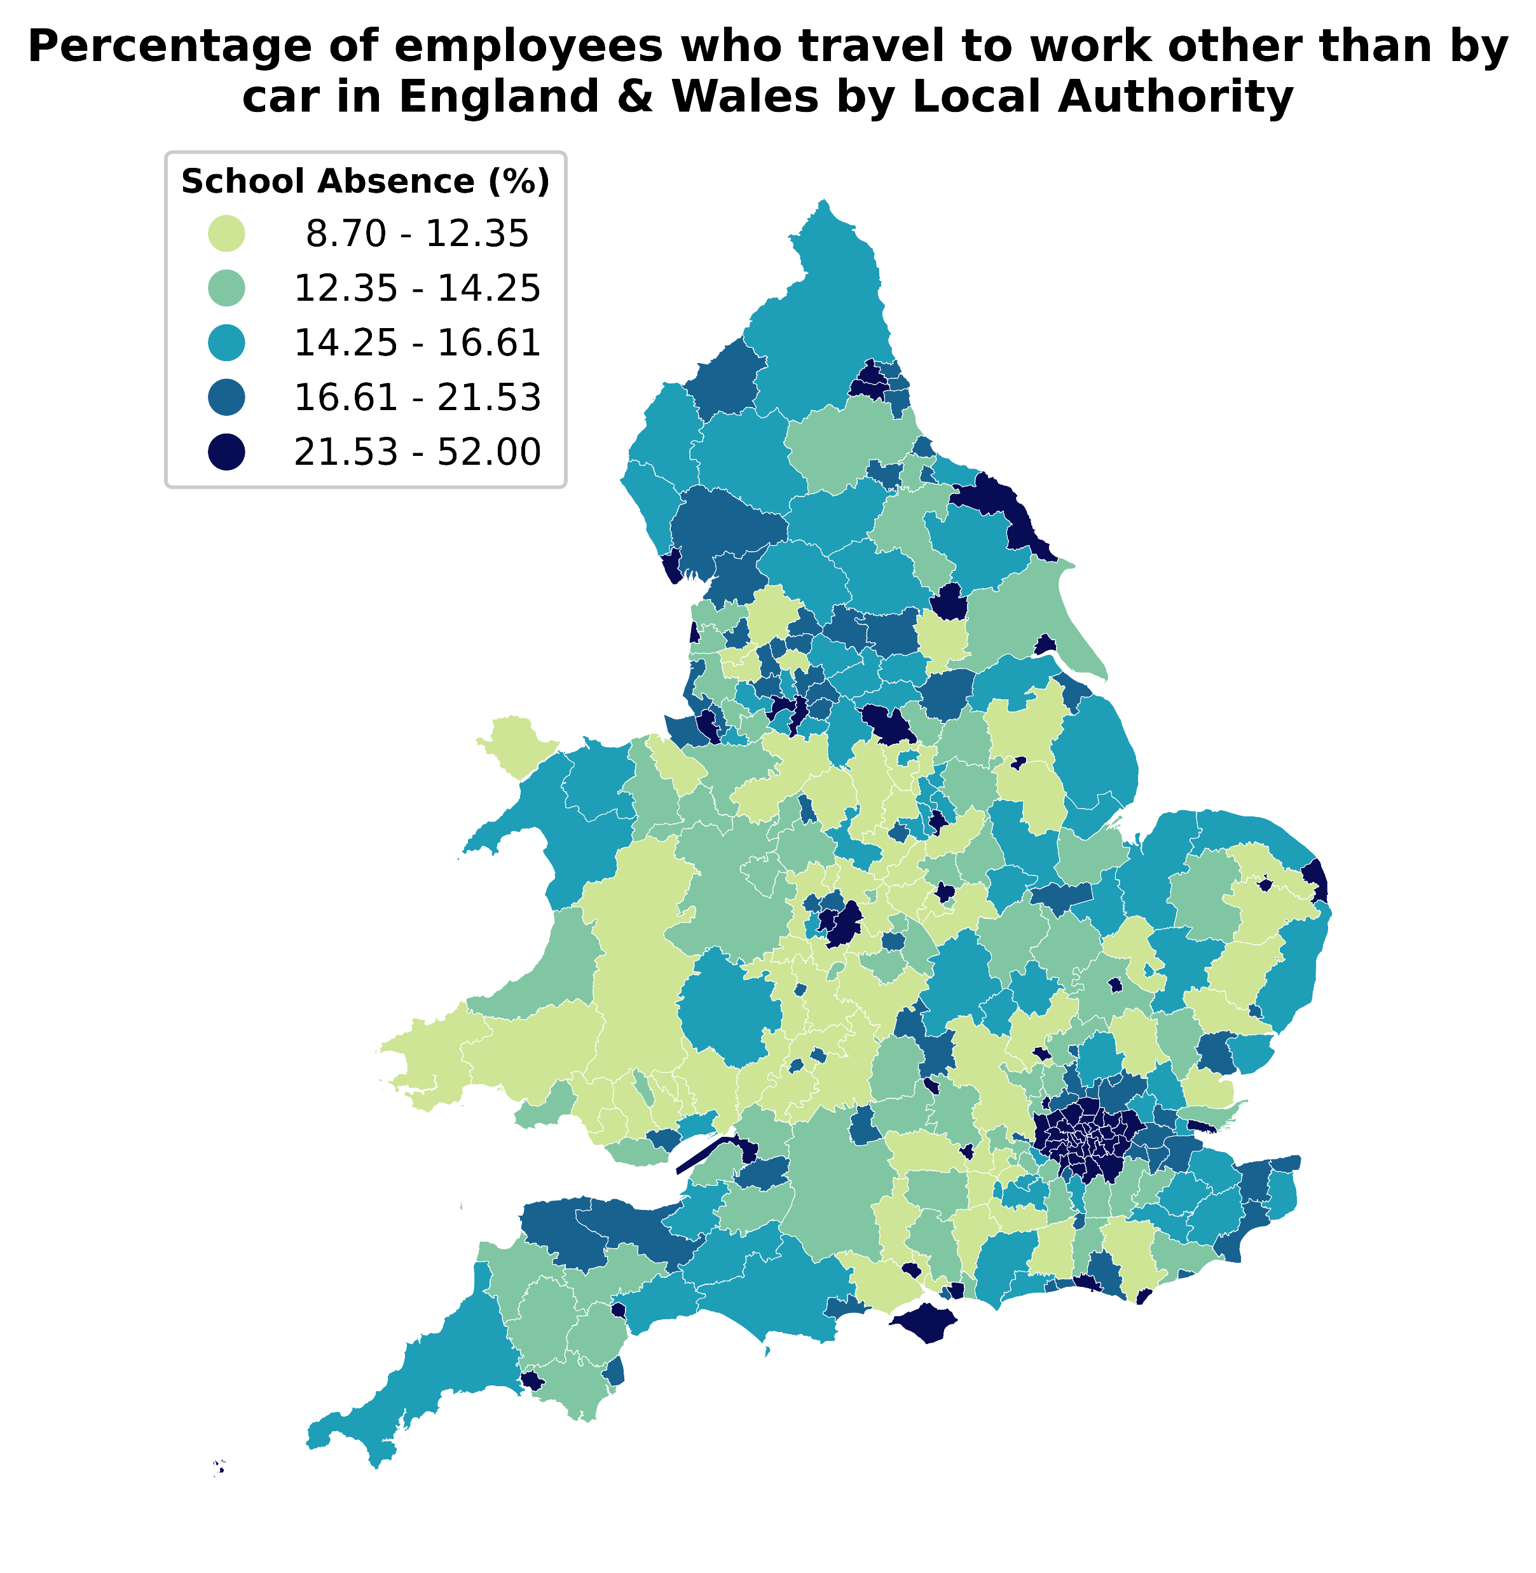
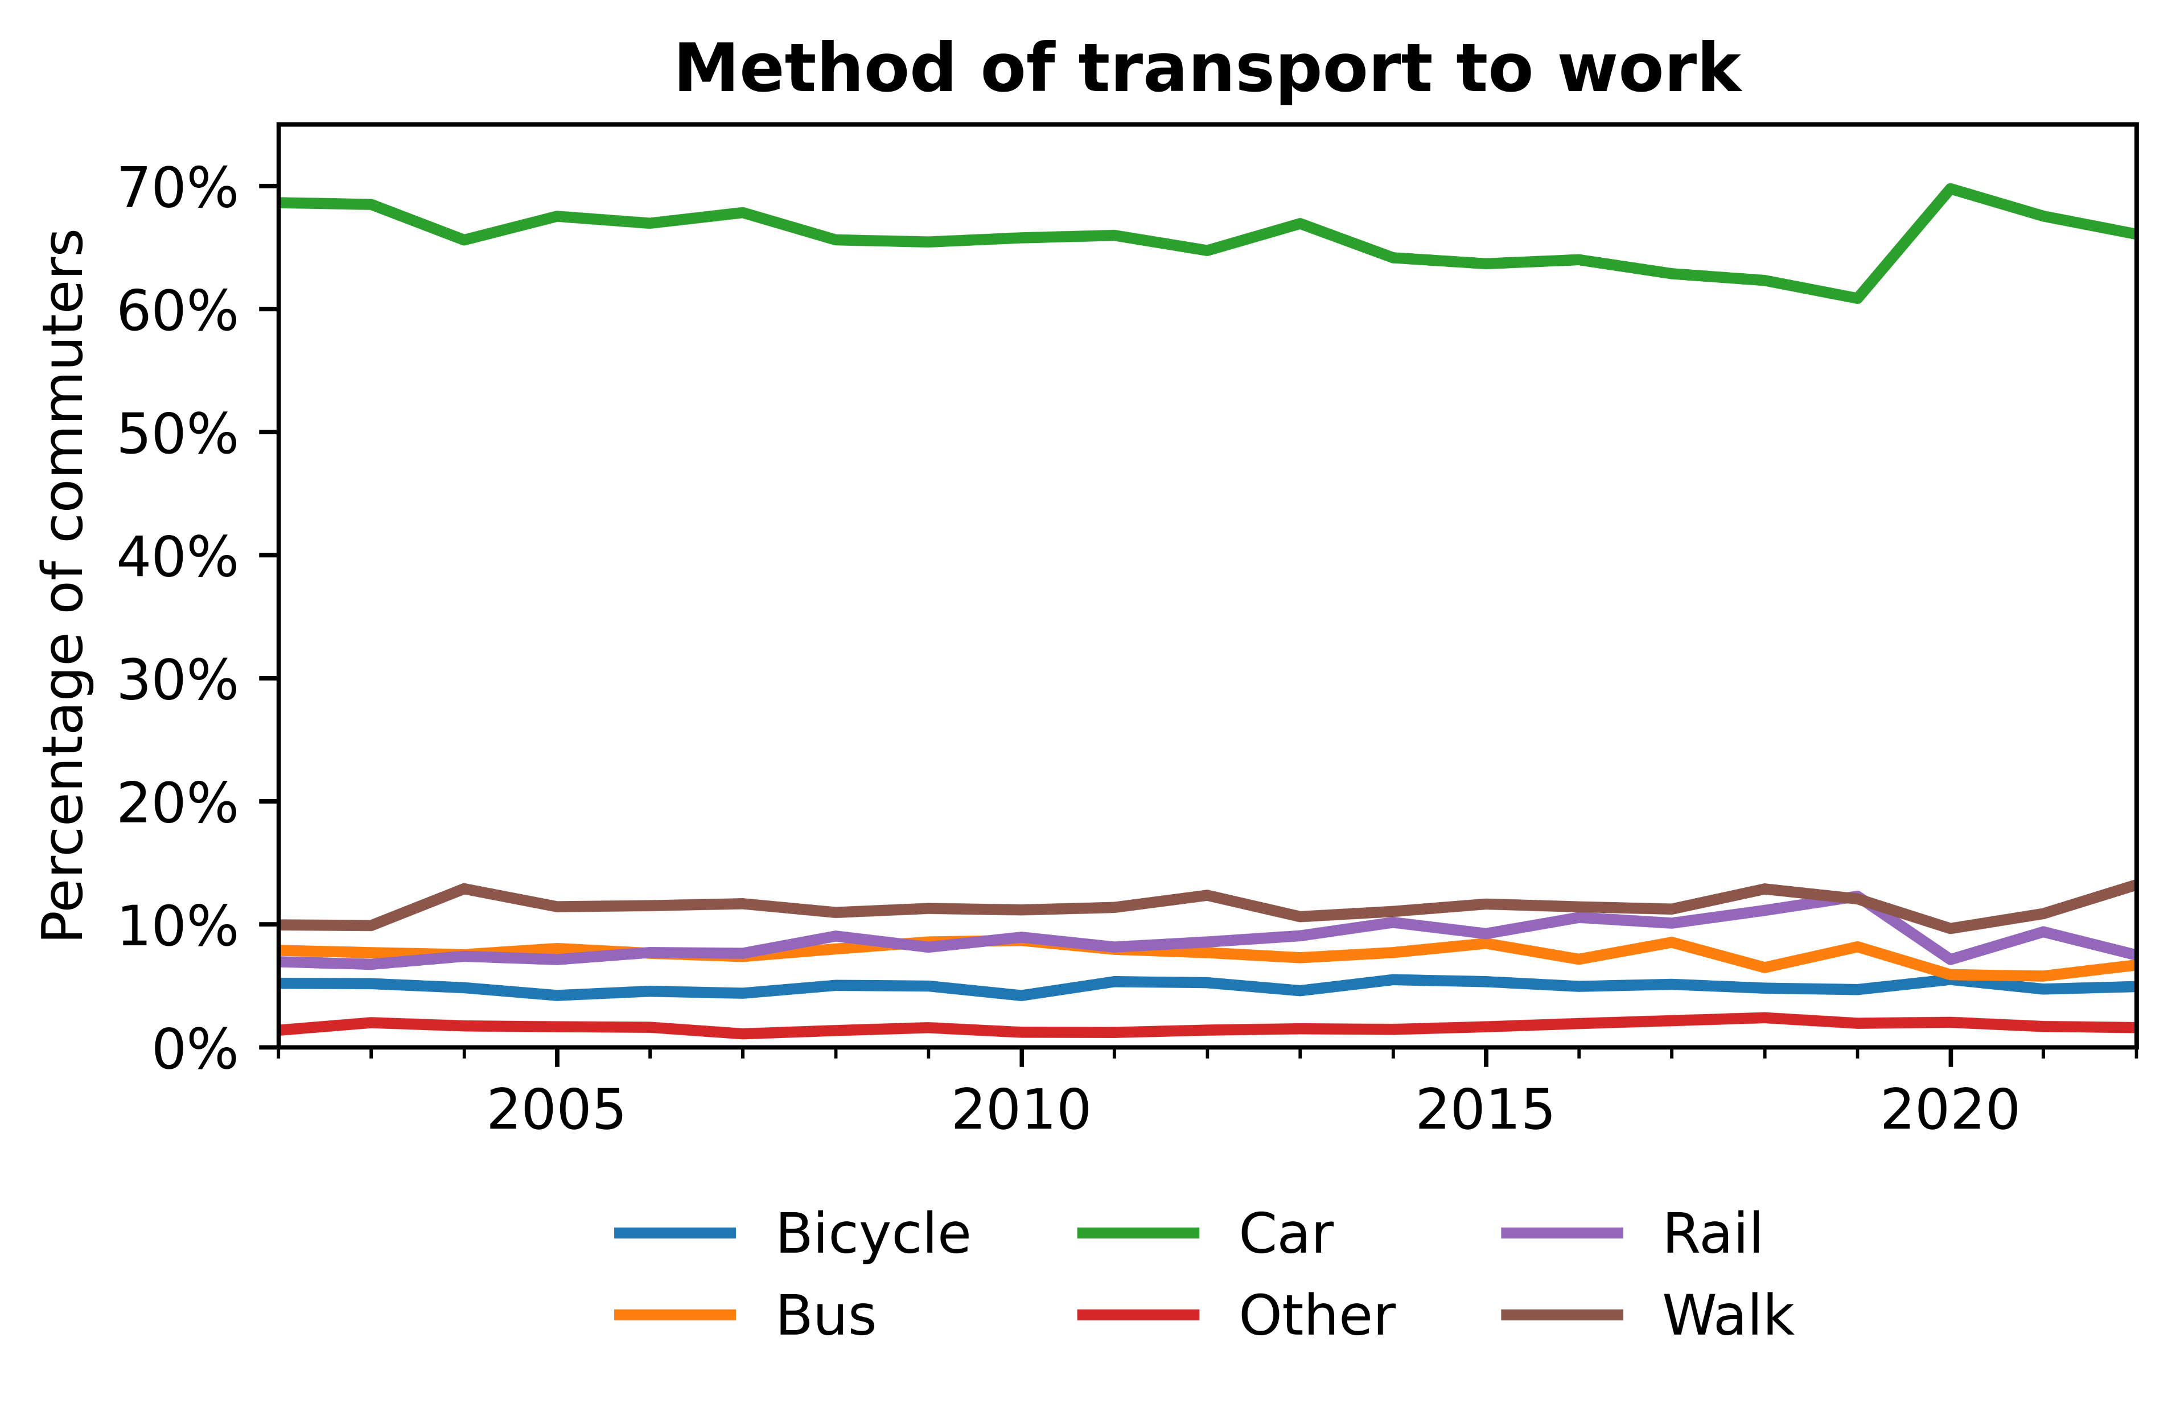
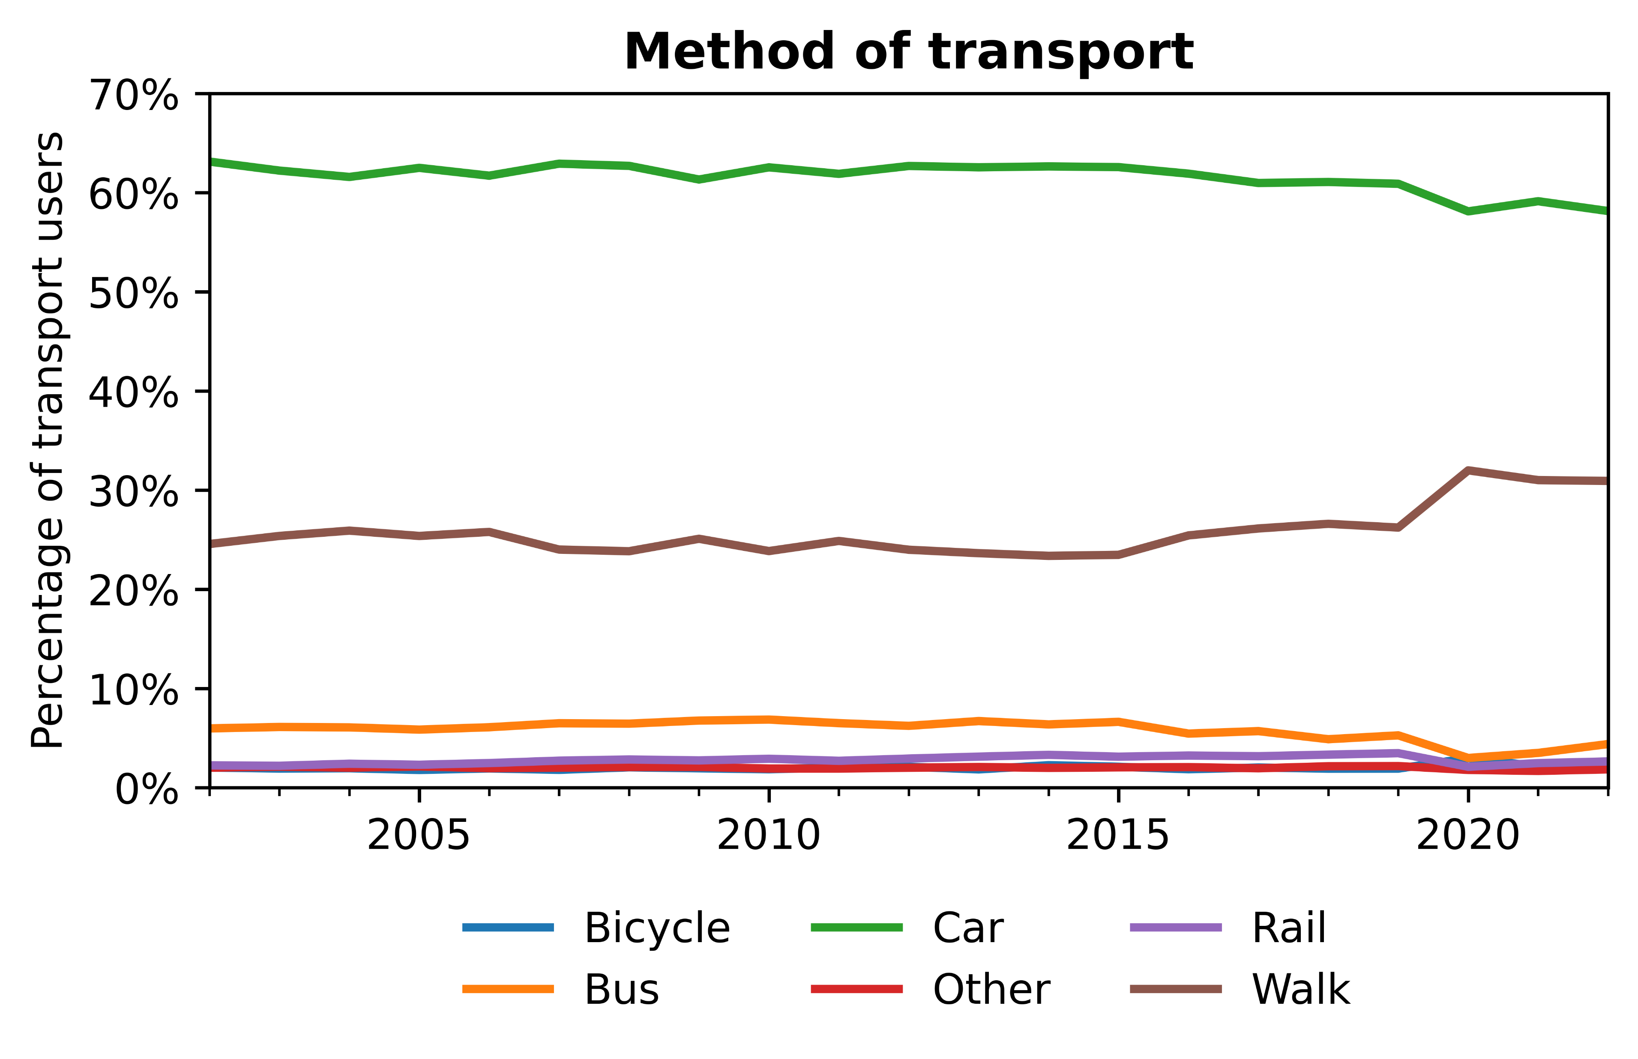
Has the increasing price of energy affect commuters’ transport habits?
Transport trends
12 levelling up missions
Welsh devolution of education
Different data collection methods
Comparability
Data Science for Policy – September 2023
4
4
Notes:
In particular, we centre our analysis around the 12 levelling up missions, of which, one of the missions is education, which has stated metrics such as the number of primary school children achieving the expected standard in reading, writing and maths. Today, we are interested in if there are spatial disparities in school absences across both England and Wales and how this links to the other levelling up metrics. The governance of education has been devolved in Wales since the creation of the Welsh assembly in 1999 and therefore the collection of school absence data is done independently between England and Wales. The differences in the data collection methods amount to things such as counting half day sessions missed instead of the percentage of pupils absent, how required attendance is counted, etc.

Slide 5
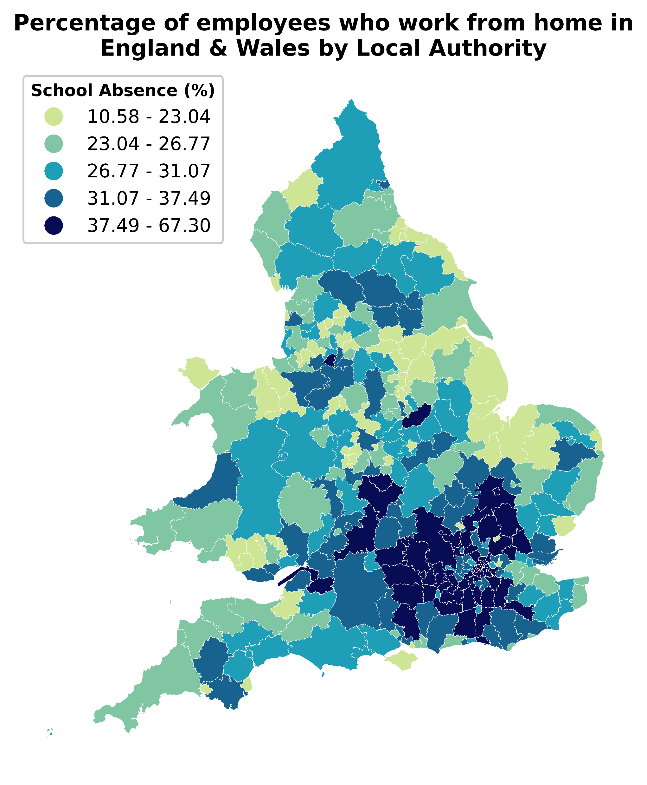
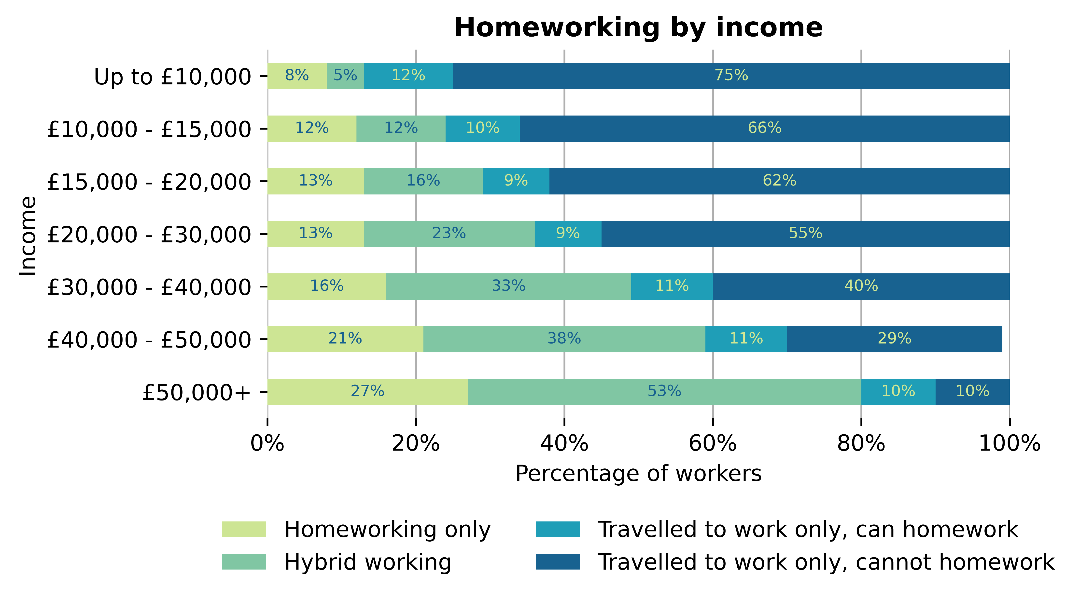
Has the increasing price of energy affect commuters’ transport habits?
Working from home
12 levelling up missions
Welsh devolution of education
Different data collection methods
Comparability
Data Science for Policy – September 2023
5
5
Notes:
In particular, we centre our analysis around the 12 levelling up missions, of which, one of the missions is education, which has stated metrics such as the number of primary school children achieving the expected standard in reading, writing and maths. Today, we are interested in if there are spatial disparities in school absences across both England and Wales and how this links to the other levelling up metrics. The governance of education has been devolved in Wales since the creation of the Welsh assembly in 1999 and therefore the collection of school absence data is done independently between England and Wales. The differences in the data collection methods amount to things such as counting half day sessions missed instead of the percentage of pupils absent, how required attendance is counted, etc.

Slide 6
Has the increasing price of energy affect commuters’ transport habits?
Limitations & future work
12 levelling up missions
Welsh devolution of education
Different data collection methods
Comparability
Data Science for Policy – September 2023
6
6
Notes:
In particular, we centre our analysis around the 12 levelling up missions, of which, one of the missions is education, which has stated metrics such as the number of primary school children achieving the expected standard in reading, writing and maths. Today, we are interested in if there are spatial disparities in school absences across both England and Wales and how this links to the other levelling up metrics. The governance of education has been devolved in Wales since the creation of the Welsh assembly in 1999 and therefore the collection of school absence data is done independently between England and Wales. The differences in the data collection methods amount to things such as counting half day sessions missed instead of the percentage of pupils absent, how required attendance is counted, etc.

Slide 7
Thank you Data Science Campus Graduate Programme September 2023
Notes:
Hi,
I hope that you are all doing well this morning, my name is Jac Williams. As a data scientists in the spatial data unit in the department of levelling up, our role involves exploring the spatial differences across the UK using data to provide insights and recommendations.

